Slide 1
OBESITA’ DI PRIMA CLASSE: QUALE TRATTAMENTO?
GIOVANNA PAVONE
Università di Foggia
Clinica Chirurgica:
Direttore Prof. Antonio Ambrosi
Scuola di Specializzazione in Chirurgia Generale:
Direttore Prof. Nicola Tartaglia

Slide 2
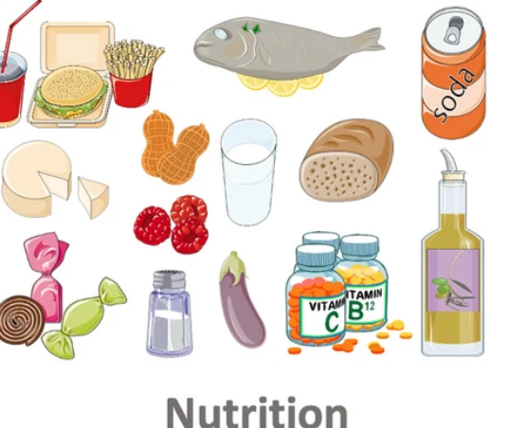
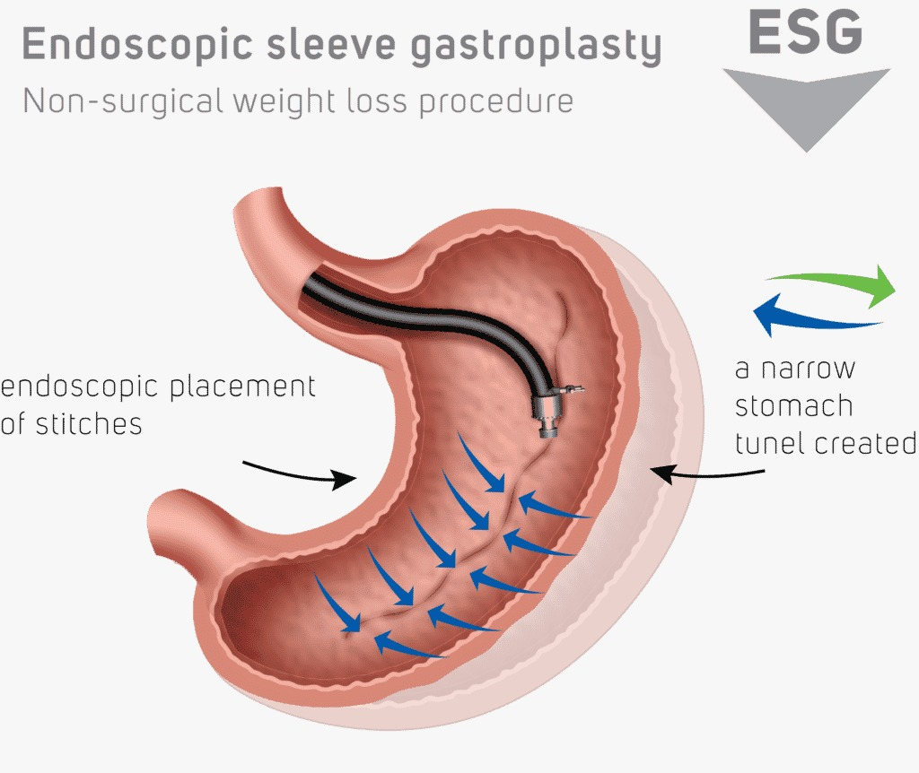
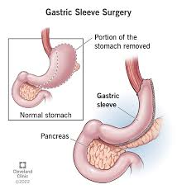
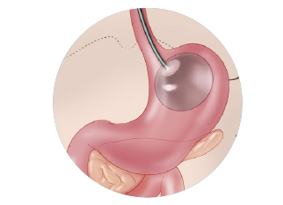

Slide 3
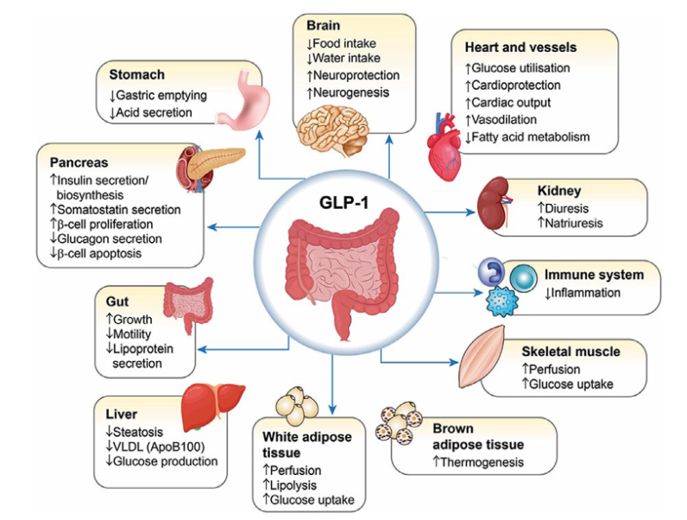
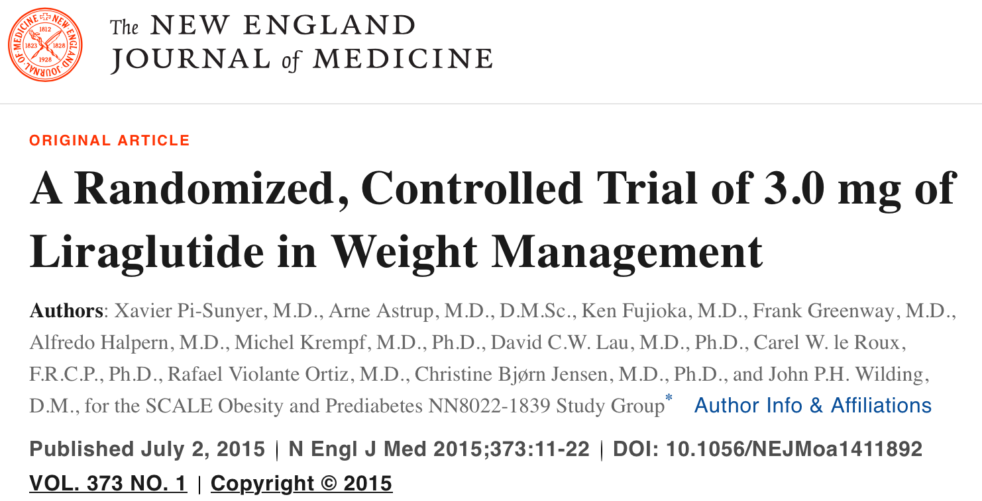
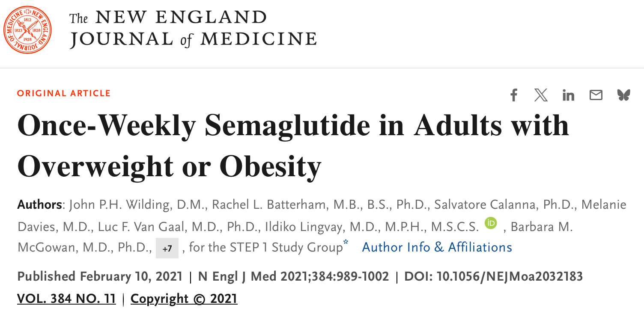
GLP-1 receptor-agonist
Indication:
Chronic weight management in adults with:
Obesity (BMI ≥30 kg/m²)
Overweight (BMI ≥27 kg/m²) with at least one weight-related comorbidity (e.g., type 2 diabetes, hypertension, dyslipidemia)
Mechanism of Action:
GLP-1 receptor agonist that:
Stimulates insulin secretion in a glucose-dependent manner
Inhibits glucagon secretion
Delays gastric emptying
Reduces appetite, contributing to weight loss
Notes:
l GLP-1 (Glucagon-Like Peptide-1) è un ormone intestinale prodotto principalmente dalle cellule L dell’intestino tenue, in risposta all’assunzione di cibo.
Indicazione: Gestione cronica del peso in adulti con:
Obesità (BMI ≥30 kg/m²)
Sovrappeso (BMI ≥27 kg/m²) con almeno una comorbidità correlata al peso (es. diabete di tipo 2, ipertensione, dislipidemia)
Meccanismo d'azione: Agonista del recettore del GLP-1 che:
Stimola la secrezione di insulina in modo glucosio-dipendente
Inibisce la secrezione di glucagone
Rallenta lo svuotamento gastrico
Riduce l'appetito, contribuendo alla perdita di peso

Slide 4
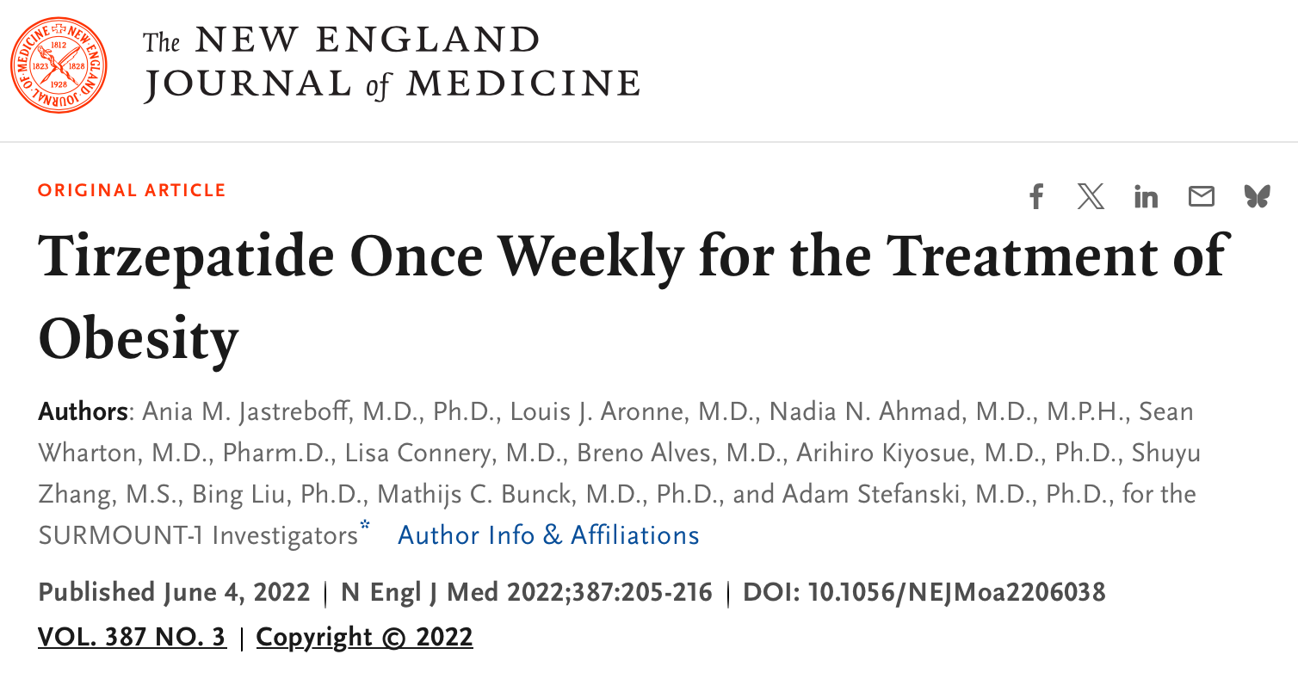
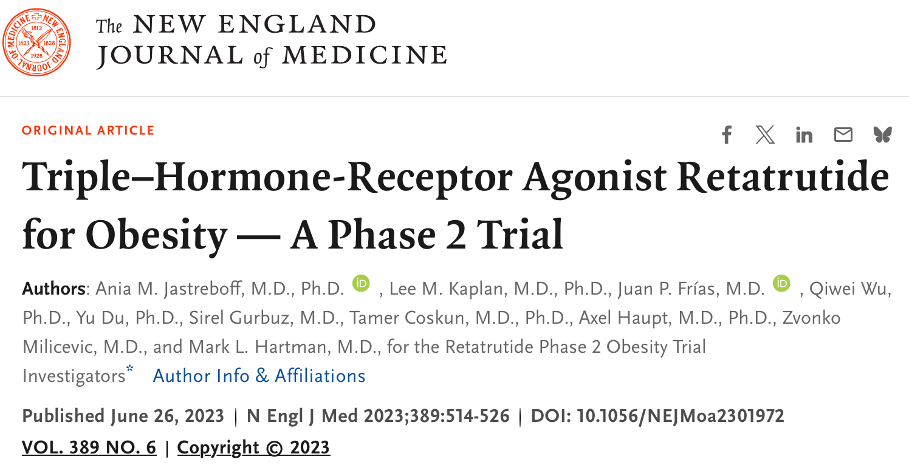
GLP-1 receptor-agonist
Dual Agonist of the Receptors:
GIP (Gastric Inhibitory Polypeptide): ▫ Increases insulin sensitivity ▫ Acts synergistically with GLP-1 for glycemic control
GLP-1 (Glucagon-Like Peptide-1): ▫ Stimulates insulin secretion (glucose-dependent) ▫ Inhibits glucagon secretion ▫ Delays gastric emptying ▫ Reduces appetite
GLP-1 (Glucagon-Like Peptide-1): Stimulates insulin secretion, inhibits glucagon secretion, and reduces appetite, contributing to weight loss.
GIP (Gastric Inhibitory Polypeptide): Another incretin hormone that stimulates insulin secretion and may improve glycemic control.
Glucagon: Although it typically acts to increase blood glucose levels, retatrutide modulates glucagon’s effects in a way that supports weight management.

Slide 5
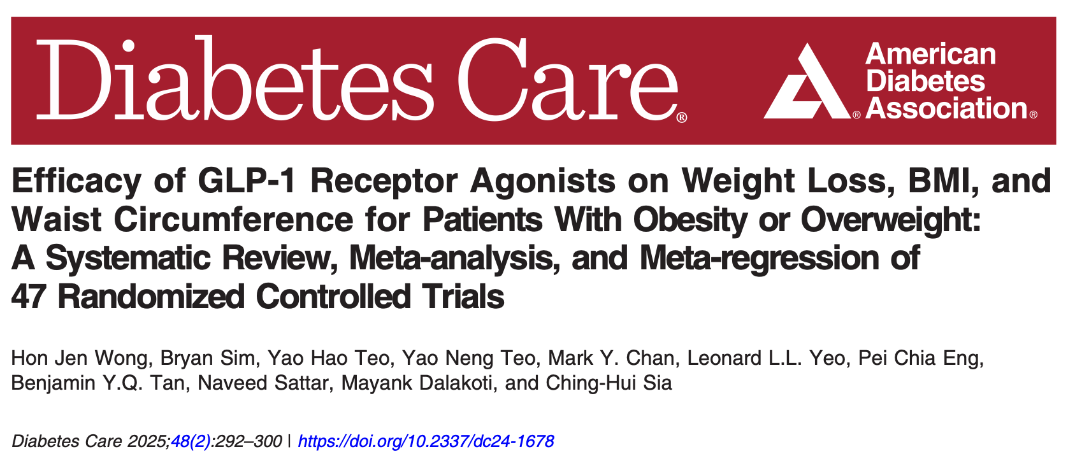
A meta-analysis of 47 randomized controlled trials (RCTs) including 23,244 participants with overweight or obesity was conducted.
Compared to placebo, GLP‑1 receptor agonists (GLP‑1 RAs) resulted in:
Average weight loss: –4.57 kg (95% CI –5.35 to –3.78),
BMI reduction: –2.07 kg/m² (95% CI –2.53 to –1.62),
Waist circumference reduction: –4.55 cm (95% CI –5.72 to –3.38).
CONCLUSIONS
We performed a meta-analysis and meta-regression on the older and latest GLP-1 RAs. GLP-1 RAs showed significant decreases in weight, BMI, and waist circumference, and the magnitude of effect may be greater in individuals without diabetes compared with individuals with diabetes. Furthermore, oral GLP-1 RAs have comparable efficacies and could offer better patient compliance.

Slide 6
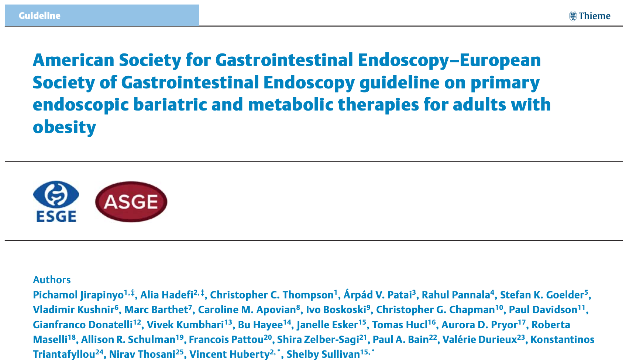
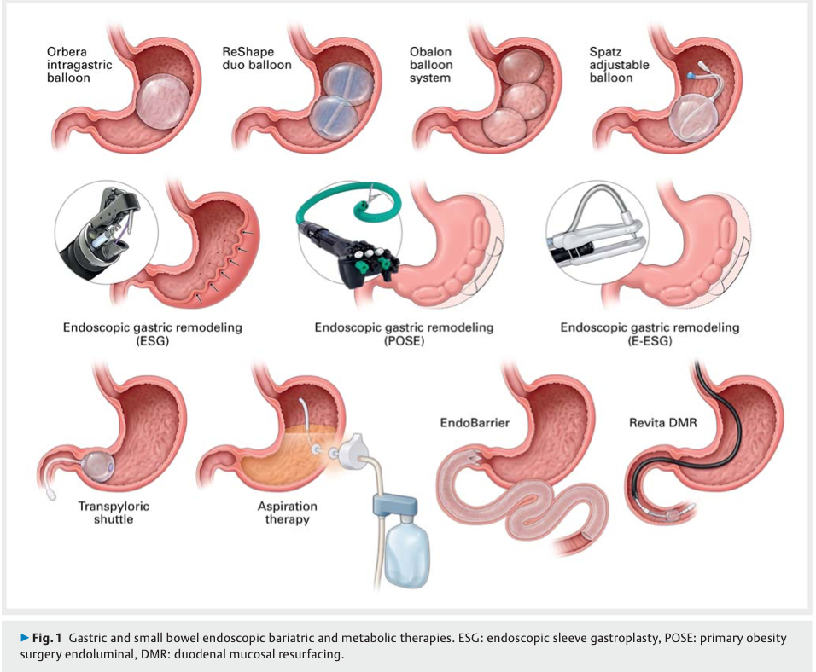
Expanded Indications The guidelines recommend the use of EBMTs in combination with lifestyle modification for patients with:
BMI ≥ 30 kg/m², and also
BMI 27–29.9 kg/m² if they have at least one obesity-related comorbidity.
Recommended Techniques The main endoscopic interventions supported include:
Intragastric balloons (IGBs),
Endoscopic gastric remodeling procedures (e.g., endoscopic sleeve gastroplasty).
Multidisciplinary Approach Required These therapies must always be combined with:
Lifestyle interventions,
Nutritional counseling,
Physical activity,
Multidisciplinary follow-up care to optimize and sustain weight loss outcomes.

Slide 7
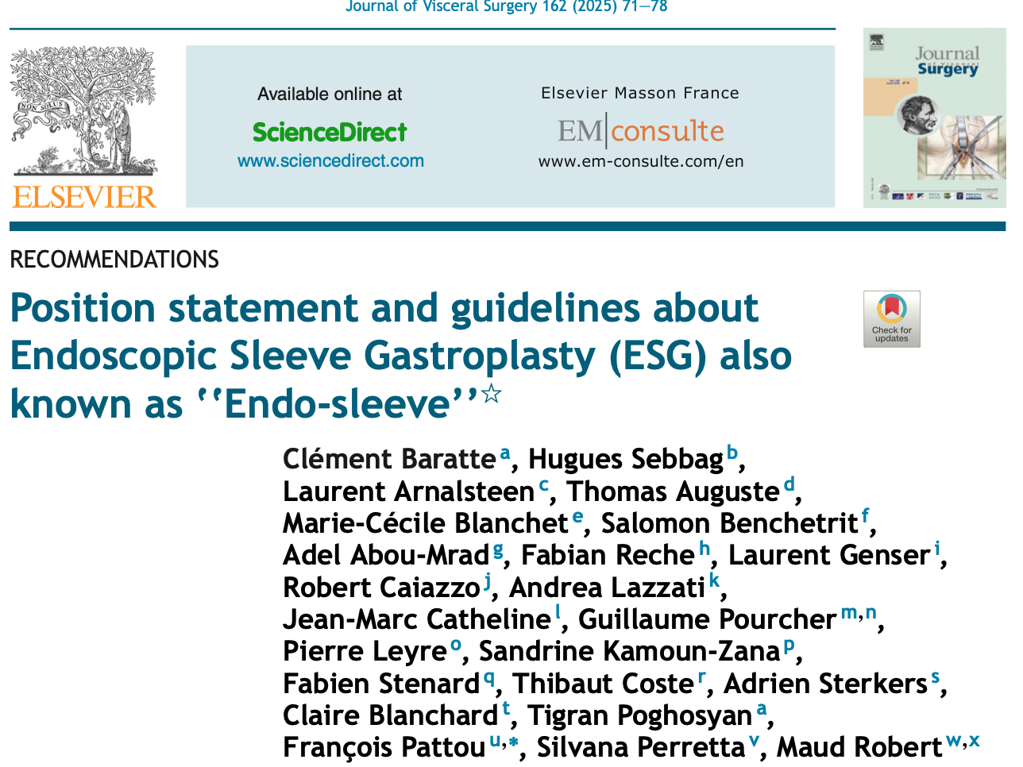
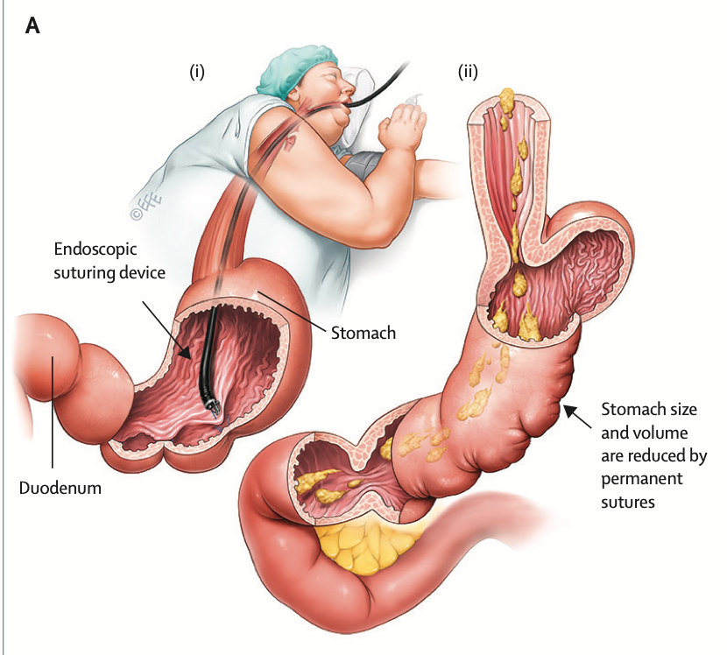
Indications: Recommended for patients with class I and II obesity, with a BMI between 30 and 40.
Efficacy: Total body weight loss of 16–17% and excess weight loss between 60% and 67% at 18–24 months.
Safety: Serious complications are rare, with rates below 1%.
Durability: Medium-term results are promising, with significant weight loss maintained up to two years.
Combination with Medications: ESG can be combined with weight loss medications, to improve outcomes.
Conclusions: ESG is a safe and effective procedure for treating class I and II obesity, with durable medium-term results.

Slide 8
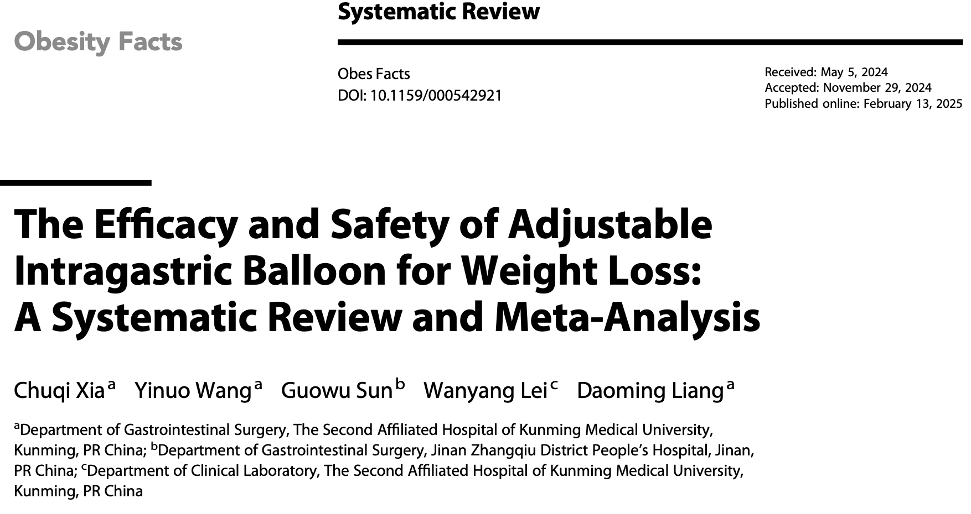
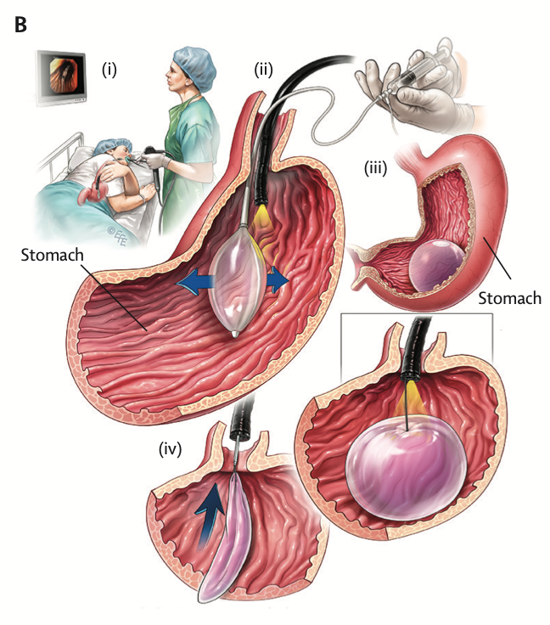
✅ Efficacy
Total Body Weight Loss (TWL): – 16.4% average loss (95% CI: 15.3–17.5%; I² = 91.2%)
⚠️ Safety & Tolerability
Early removal (<3 mo): 5.7% (95% CI: 3.5–7.8%)
Stomach ulcer cases: 1.1% (95% CI: 0.8–1.4%)
✅ Conclusion
aIGB provides significant and sustained weight loss
Safety profile acceptable

Slide 9
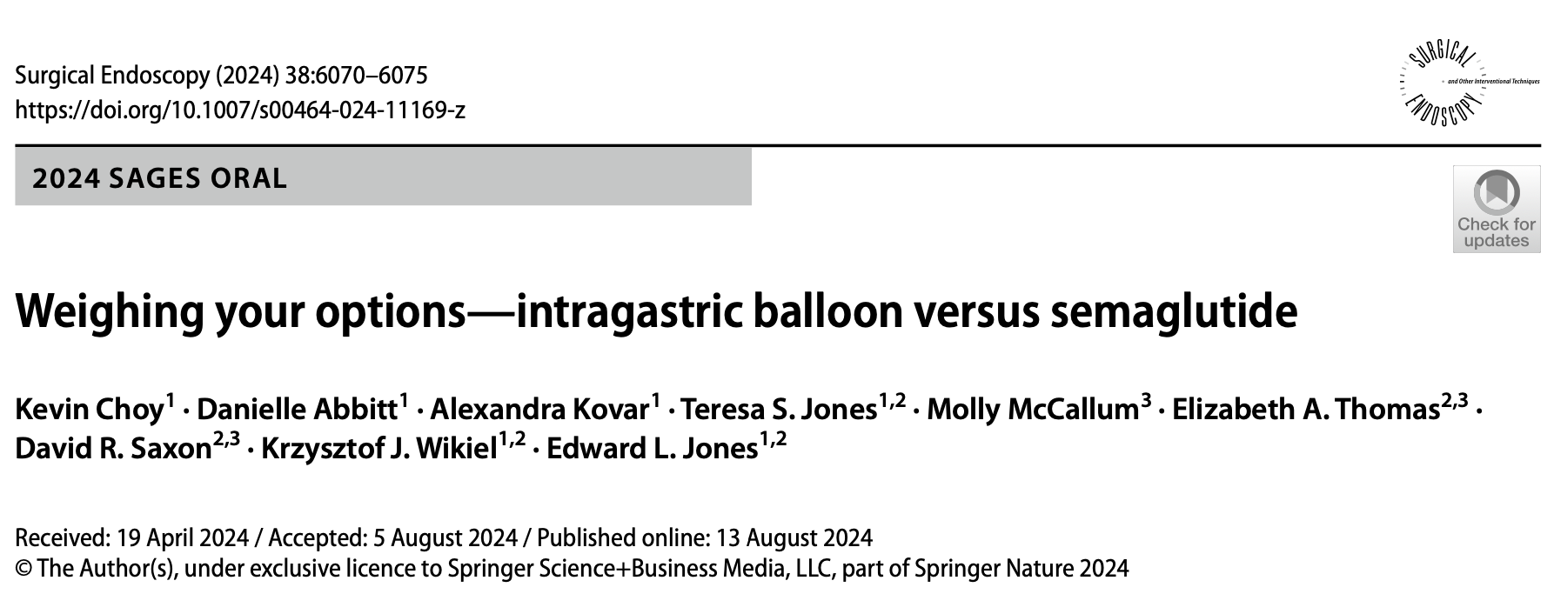
Intragastric Balloon (IGB):
Produces more rapid weight loss in the first 3–6 months (−12.7 kg vs. −9.4 kg).
Associated with significant weight regain after removal (average +3 kg from 6 to 12 months).
Best used as a short-term bridge to surgery, especially in preoperative candidates.
Semaglutide:
Induces more gradual but sustained weight loss (continued weight reduction up to 12 months).
Shows better long-term maintenance compared to IGB.
Overall Recommendation:
Semaglutide may be more appropriate for long-term obesity management.
Future research should explore combined therapy (IGB + semaglutide) to optimize both early and sustained weight loss
To evaluate which intervention is more cost-effective—semaglutide (a GLP-1 receptor agonist) or ESG
Conclusions
ESG is more cost-effective than semaglutide over a 5-year period.
ESG leads to:
Greater weight loss
Higher QALYs
Lower overall cost
Semaglutide would need a ~70% price reduction to be cost-competitive.
Results are robust across sensitivity analyses.
2024

Slide 10
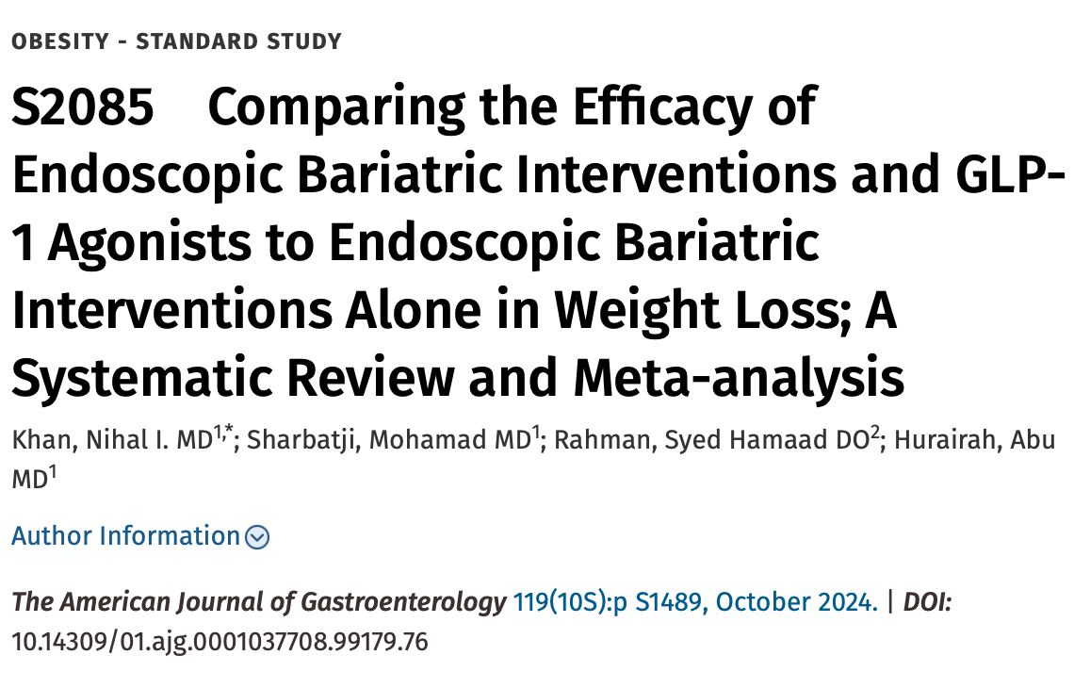
Conclusion: Our meta-analysis demonstrates that the use of GLP-1 agonists alongside endoscopic bariatric treatment is superior to the use of endoscopic bariatric treatment alone for mean absolute body weight loss at follow-up. Further studies are required to evaluate the safety and adverse events comparing these 2 treatment modalities and to discover diﬀerences between comparing the 2 endoscopic options to various GLP-1 agonists

Slide 11
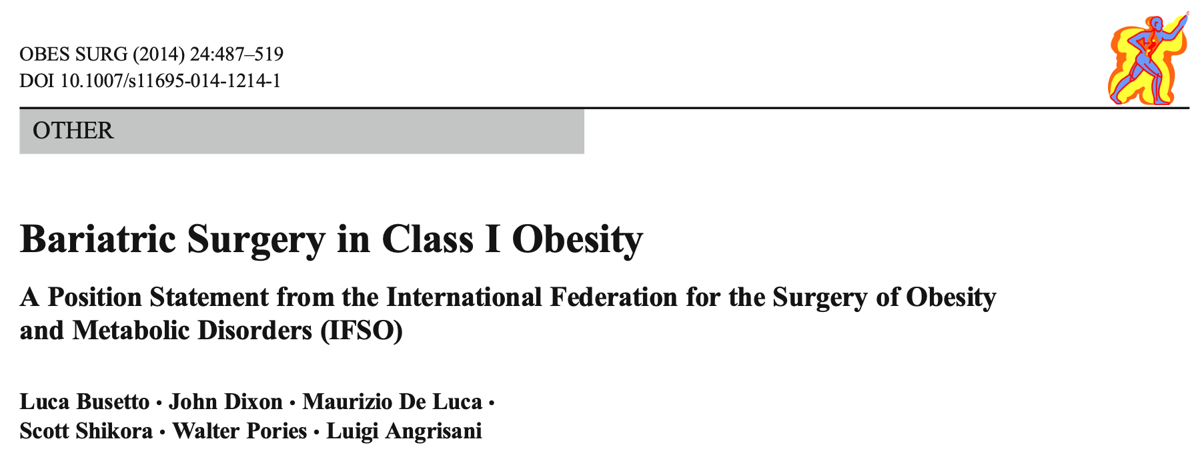
Variable Impact Health burden of class I obesity varies individually but can be significant physically, psychologically, and socially.
Non-Surgical Treatments May achieve meaningful weight loss, but long-term maintenance is limited.
Effectiveness of Surgery Bariatric surgery is effective for short-term weight loss in class I obesity.
Safety Profile Adverse events are comparable to those in morbid obesity; serious events are rare but possible.
Eligibility Beyond BMI Surgery should not be denied based solely on BMI—especially when comorbidities are present.
Individualized Assessment Surgical indication must be based on comprehensive health evaluation and future disease risk.
Comorbidity-Driven Indication Surgery should be considered based on the burden and treatability of comorbidities, not just BMI.
Avoid in Frail Patients Not recommended for frail patients where weight loss may not improve prognosis or may be harmful.
Age Limitations Surgery currently not advised for children/adolescents or elderly patients with class I obesity.
Healthcare System Considerations National health systems should adapt recommendations to local resources and needs.
Notes:
Impatto variabile L’impatto sulla salute dell’obesità di Classe I varia da persona a persona, ma può essere significativo a livello fisico, psicologico e sociale.
Terapie non chirurgiche Possono portare a cali di peso clinicamente rilevanti, ma sono spesso poco sostenibili a lungo termine.
Efficacia della chirurgia La chirurgia bariatrica è efficace nel breve termine per la perdita di peso.
Profilo di sicurezza Il rischio di eventi avversi è simile a quello nei pazienti con obesità grave.
Idoneità oltre il BMI L’accesso alla chirurgia non dovrebbe basarsi solo sul BMI, specie in presenza di comorbidità.
Valutazione individuale L’indicazione chirurgica deve basarsi su una valutazione complessiva della salute e del rischio futuro.
Comorbidità come criterio guida L’indicazione deve dipendere più dalla gravità delle comorbidità che dal solo livello di BMI.
Esclusione dei pazienti fragili La chirurgia non è raccomandata nei pazienti fragili, dove il calo ponderale può non essere utile o persino dannoso.
Limiti d’età Attualmente non è raccomandata per bambini, adolescenti o anziani con obesità di Classe I.
Contesto sanitario Le decisioni devono adattarsi alle risorse e priorità dei singoli sistemi sanitari locali.
Evidenze insufficienti Sono necessari più studi controllati a lungo termine; le nuove tecniche devono essere validate in modo rigoroso.

Slide 14
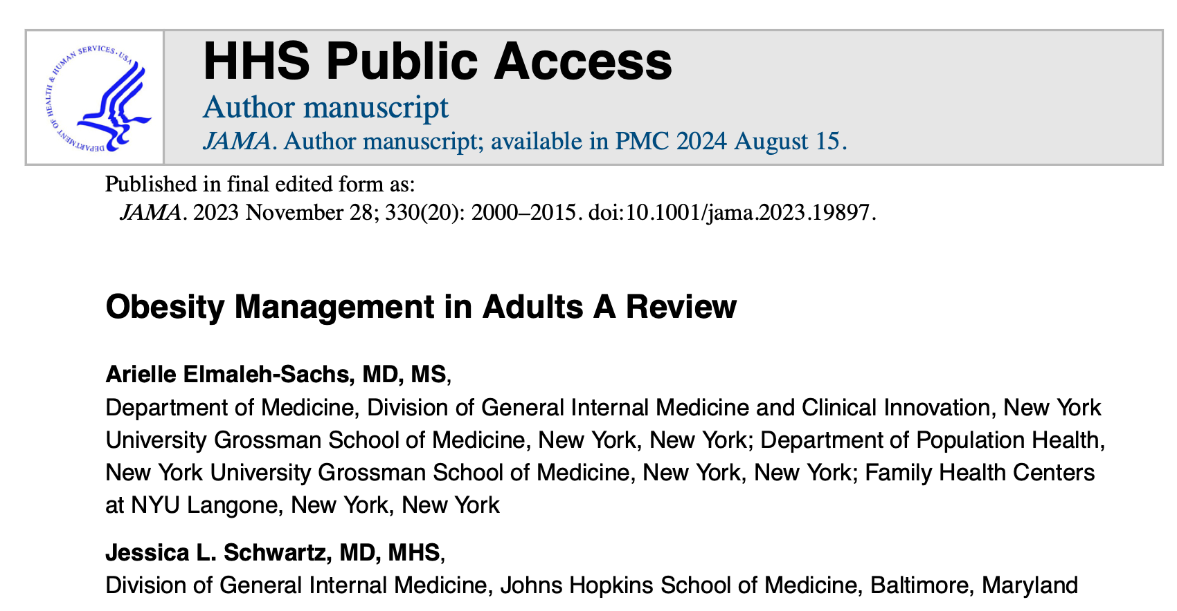
Conclusion Obesity is a common and complex condition. Effective treatments include:
Behavioral interventions: −5–10%
Pharmacological therapies (GLP-1, GIP/GLP-1): −8–21%
Bariatric surgery: −25–30% A multidisciplinary and personalized approach is essential, combining various therapeutic strategies tailored to each patient.
CONCLUSION AND RELEVANCE—Obesity affects approximately 42% of adults in the US. Behavioral interventions can attain approximately 5% to 10% weight loss, GLP-1 agonists and glucose-dependent insulinotropic polypeptide/GLP-1 receptor agonists can attain approximately 8% to 21% weight loss, and bariatric surgery can attain approximately 25% to 30% weight loss. Comprehensive, evidence-based obesity treatment combines behavioral interventions, nutrition, physical activity, pharmacotherapy, and metabolic/bariatric procedures as appropriate for individual patients.
Notes:
Definizioni
Sovrappeso: BMI ≥ 25
Obesità: BMI ≥ 30 (Soglie più basse per popolazioni asiatiche: BMI ≥ 25-27,5)
Il solo BMI non è sufficiente a valutare il rischio individuale.
Rischio cardiovascolare
Uomini con BMI 30–39: 20,21 eventi/1000 persona-anni vs. 13,72 in uomini normopeso
Donne con BMI 30–39,9: 9,97 eventi/1000 persona-anni vs. 6,37 in donne normopeso
Benefici della perdita di peso
Perdita del 5–10%:
↓ Pressione sistolica di ~3 mmHg (in ipertesi)
↓ HbA1c di 0,6–1% (in diabetici tipo 2)
Trattamento dell’obesità: 5 categorie principali
Interventi comportamentali (≥14 sessioni in 6 mesi):
Monitoraggio del peso
Educazione alimentare e attività fisica
Problem solving → 5–10% di perdita di peso ⚠️ Ripresa ponderale nel 25% entro 2 anni
Nutrizione:
Riduzione calorica
Strategie adattate alle preferenze del paziente
Attività fisica:
Meno efficace senza restrizione calorica (−2-3 kg)
Fondamentale per il mantenimento del peso
Farmacoterapia:
Attenzione ai farmaci che causano aumento di peso (es. mirtazapina, insulina)
Farmaci anti-obesità consigliati per pazienti con obesità o sovrappeso con comorbidità:
GLP-1 agonisti (semaglutide, liraglutide)
Tirzepatide (GIP/GLP-1 agonista) → −21% peso in 72 settimane
Fentermina-topiramato
Naltrexone-bupropione
Orlistat
Procedure metaboliche e bariatriche:
Endoscopiche (pallone gastrico, sleeve endoscopica): −10–13% a 6 mesi
Chirurgiche (sleeve, bypass): −25–30% a 12 mesi
Conclusione
L'obesità è una condizione comune e complessa.
Trattamenti efficaci:
Comportamentali: −5–10%
Farmacologici (GLP-1, GIP/GLP-1): −8–21%
Chirurgia bariatrica: −25–30%
È essenziale un approccio multidisciplinare e personalizzato, combinando i vari strumenti terapeutici per ogni paziente.

Slide 15
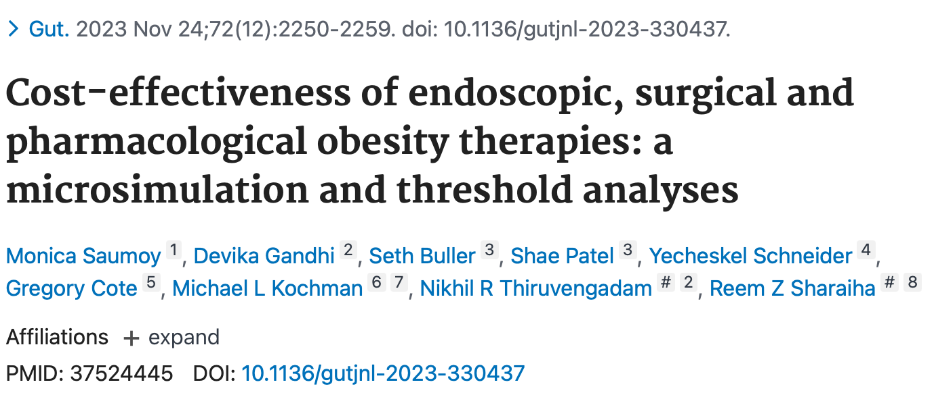
✅ Conclusions
Cost-effective options:
ESG for Class I obesity
SG for Class II/III obesity
Semaglutide could be cost-effective only if its price is substantially reduced
Despite cost, semaglutide could potentially lead to the greatest mortality reduction due to higher patient uptake.

Slide 16
Conclusions: Class I Obesity – Choosing the Right Therapeutic Approach
Approach | Weight Loss (TBWL) | Invasiveness | Durability | Cost-Effectiveness | Ideal Patient Profile
Pharmacotherapy | ~10–15% (e.g., GLP-1 analogs) | Low | Moderate (ongoing use) | Variable (↓ if long-term) | Prefers non-invasive; early-stage obesity
Endoscopic Procedures | ~15–20% (e.g., ESG) | Minimally invasive | High (≥5 years) | High (better than GLP-1) | Motivated, BMI 30–35, not eligible for surgery
Bariatric Surgery | >25% (e.g., sleeve, bypass) | High | Very high (long-term) | High in eligible patients | Rarely indicated; only if severe comorbidities

Slide 17
Grazie per l’attenzione

